Slide 1
Outreach to People with Disabilities and Others with Access and Functional Needs
November 12, 2015
Notes:
This 1 hour scenario based training.

Slide 2
NYCEM Moving Forward
Individual Preparedness
Communications
Agenda

Slide 3
Commitment to inclusive planning
Staff hired throughout NYCEM and other agencies with focus on disabilities
Communications – technology and alerts
Outreach- pre and post event
Sheltering
Transportation
Evacuation

Slide 4
ADA Shelters
8 Accessible Shelters for 2015
Over 65 EC/HS in the future
Staff position to focus on accommodations
Surveyed by professional ADA firm for accessibility and remediated as needed
Signage using pictograms
Better communication for persons who are deaf or hard of hearing
Extra Amenities/supplies
Wheelchairs, scooter chargers, walkers, canes, power strips, higher cots, refrigerators for medication, adult diapers, magnifying glass, etc…

Slide 5

EDUCATING AND ENGAGING THE PUBLIC
Notes:
Our Preparedness Campaign Includes:
Multi-lingual Ready New York publications
Public service announcements
Advertising campaign
Corporate and non-profit partnerships
Extensive community outreach programs (CERT, Citizen Corps)

Slide 6
INDIVIDUAL PREPAREDNESS

Slide 7
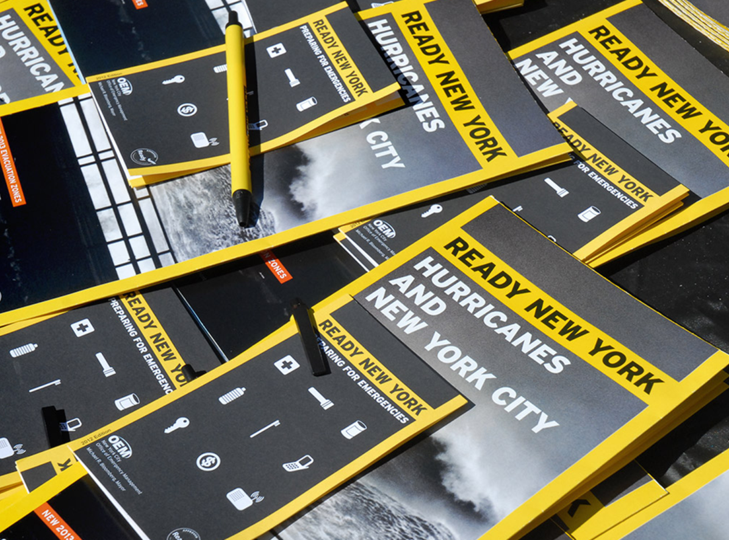
READY NEW YORK
Encourages New Yorkers to be ready for all types of emergencies.
Guides available in up to 13 languages and audio format
The Ready NY video is available in the four most spoken languages in NYC
Offer presentations, including workshops and fairs, for all ages and do specific outreach to senior centers and other vulnerable populations
Request an Event: NYCEM will send knowledgeable staff members and emergency response volunteers to educate your organization about preparing for emergencies.
* ASL interpreter available when requested.
Notes:
We’re currently making sure that everything on our website is accessible through a screen reader

Slide 8

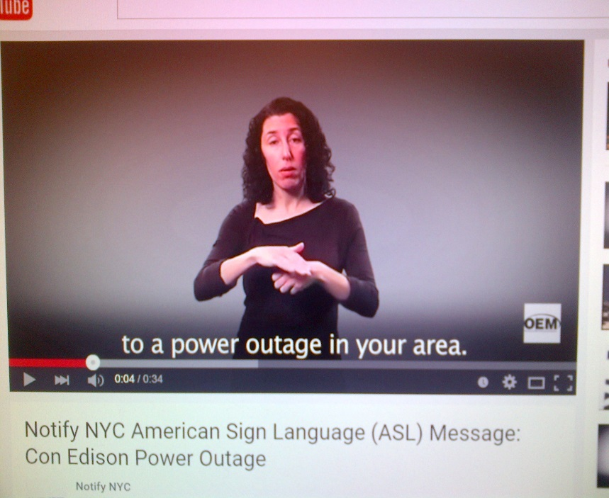
Notifications & networks
NYC Emergency Management social media:
Twitter
Facebook
YouTube
Instagram
LinkedIn
Tumblr
Notify NYC is the City of New York's official source for information about emergency events and important City services. Registration is free.
•

Slide 9
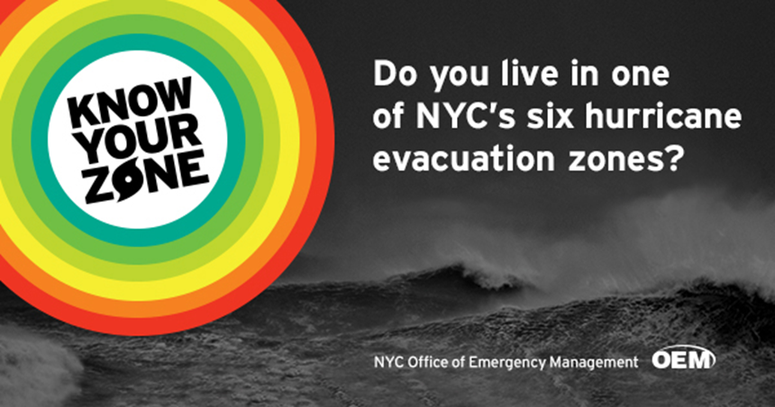

Campaigns and PSA
In 2014, NYC Emergency Management launched the Know Your Zone campaign.
Transportation advertising, including subways
Social media campaign
Motiongraphic
Work with Ad Council to develop campaigns that encourage New Yorkers to be prepared ahead of disaster

Slide 10
COMMUNITY PREPAREDNESS

Slide 11
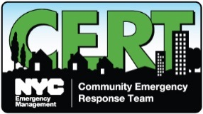
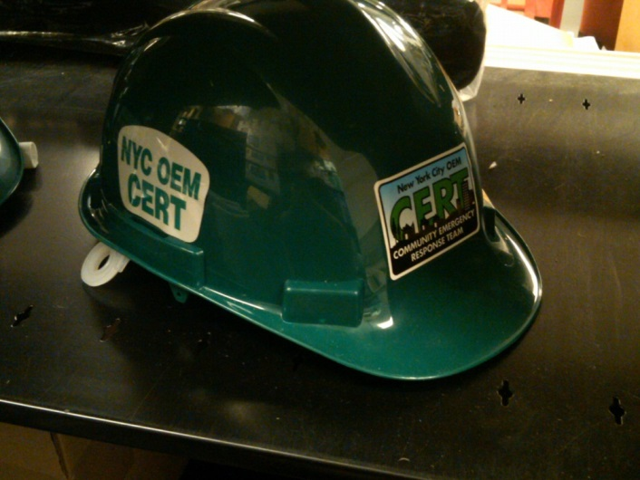
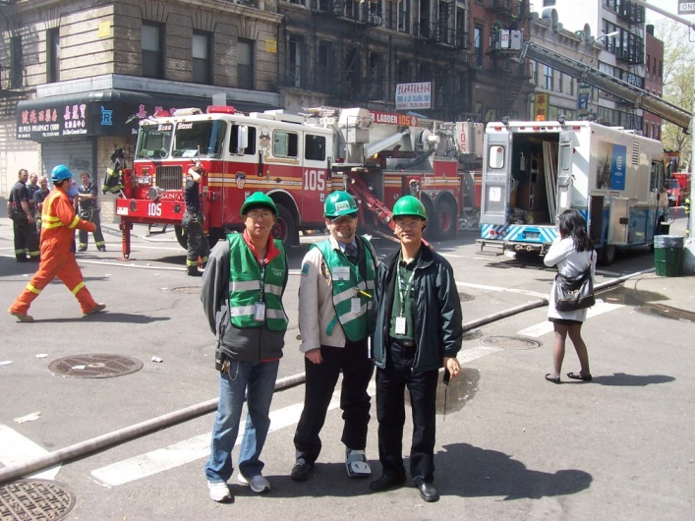
NYC COMMUNITY EMERGENCY RESPONSE TEAM (CERT)
CERT engages individuals in becoming a part of their community’s emergency response team. NYC Emergency Management has managed the CERT program since CERT’s inception in 2003
NYC CERT Teams (as of May 2014):
54 active teams
1,800 active members
Training:
Work with populations with access and functional needs
Community Disaster Network program
Deployment is through NYCEM’s Watch Command for:
Emergency incidents
Planned events
Notes:
CERT is inclusive of everyone in the community and has several members from the DAFN community that include vision and hearing impaired, as well as mobility impaired

Slide 12

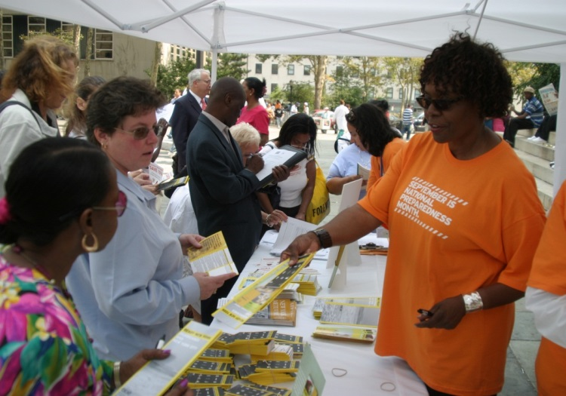
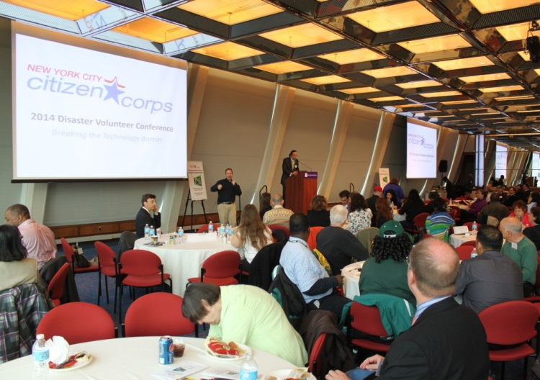
NYC Citizen Corps
NYC Citizen Corps works with community-based organizations to increase preparedness, response and recovery capabilities at the local level.
Partners: Because such organizations are vital to the community, NYC Citizen Corps engages healthcare facilities, advocacy organizations, faith-based institutions, and other community-based organizations
Planning: We offer tools to community based structures such as long term recovery groups, civic associations, etc. to assist in strengthen local planning, coordination, and response.
Education and Outreach: Through NYC Citizen Corps, community members can get connected to a variety of tools, resources, and trainings to ensure they are informed and prepared.
Notes:
Citizen Corps engages organizations in the nonprofit and community-based sectors
In development- Community Emergency Planning toolkit which offers information and guidance to communities about how they can plan for emergencies. Will prioritize DAFN considerations and how to be inclusive as possible.

Slide 13
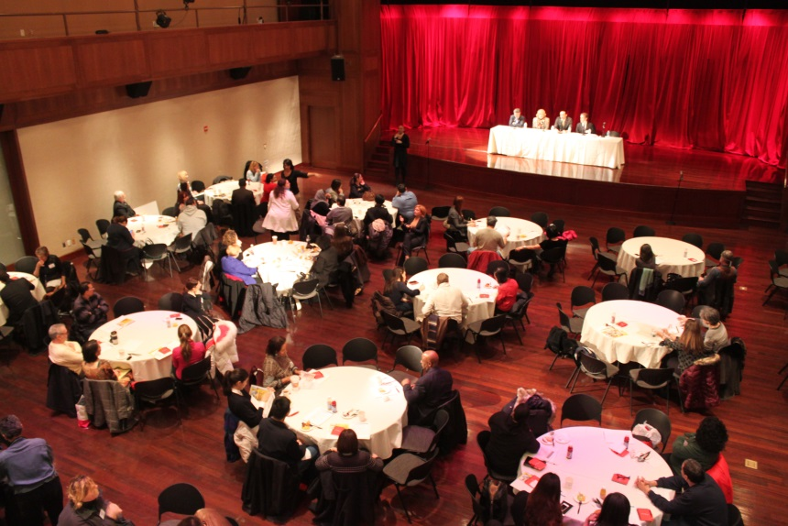
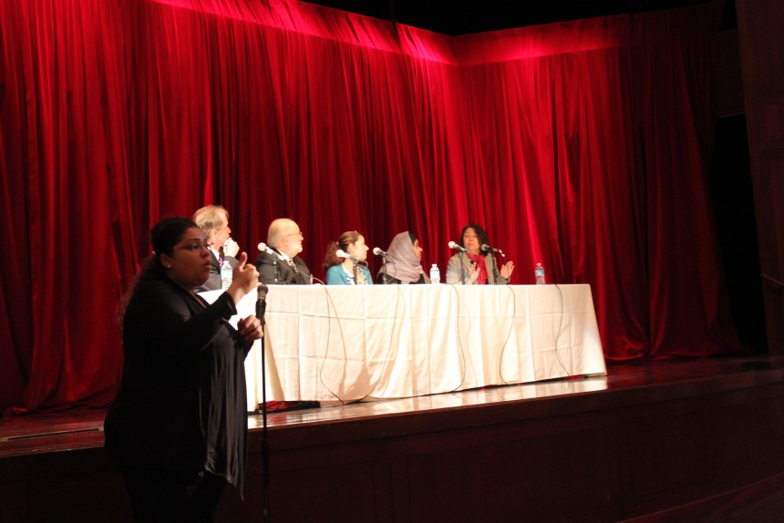
Access and Functional Needs Symposium
We have hosted this event since 2010 to bring together service providers, consumers, advocates and community stakeholders to address planning for people that require a higher level of support during emergencies.
Topics have included:
Basic preparedness for individuals with access and functional needs
Identifying barriers to emergency planning for the disability community
Exploring solutions to the challenges of emergency planning for people with disabilities or other access and functional needs
Leveraging partnerships
Notes:
One of the topics we are covering at this event is sheltering (give overview and get feedback)
How the coastal storm shelter system works:
Evacuees without alternate accommodations will report to an Evacuation Center. Once at the Evacuation Center, evacuees visit detour areas as needed (medical screening, animal assistance, and family reunification) before being transported to a shelter.
Hurricane Shelters - are safe facilities out of the evacuation zones that offer essential services to preserve the health and safety of evacuees. The City will provide basic mass care support items that include food, water, baby formulas, blankets and other durable medical goods, and disabilities/access functional needs supplies.
Special Medical Needs (SMN) Shelters - are located throughout the five boroughs for evacuees who do not require hospital or nursing home care, but require specialized assistance based on their present condition or medical history. The City will provide special medical needs cots, along with other special medical needs items, over-the-counter kits, etc.
DAFN improvements
Added items to emergency sheltering stockpile (clothing, diapers, cribs)
Special Medical Need Shelters
Improved Signage

Slide 14

Emergency messaging for Individuals with disabilities and others with access and functional needs
Creating a centralized registry of people with disabilities is not the right solution for this challenge – there are privacy concerns and people with disabilities should not be forced onto a list.
Advance Warning System (AWS)

Slide 15
How does Advance Warning Work?
Emergency Messaging is delivered to agencies and organizations that have developed trusted relationships with their clients
Agencies and organizations can tailor communication and support to their client’s specific needs
Messaging can take the form of E-mails or text messages deployed prior to an emergency, during the incident or in periods of recovery, in the future we’ll add automate phone calls as well
Conference calls are held with pre-identified umbrella service agencies (eg HRA, OPWDD, etc.)
Information is posted on the AWS website.

Slide 16
Feedback on Emergency Messaging
Are there people beyond service providers that we should be reaching out to? Are there voices in the community that we should be reaching out to?
Advocates?
Influential Bloggers?
Others who can amplify our messaging?
What other kinds of information would you like to see in emergency alerts?

Slide 17
NYCEM ACCESS AND FUNCTIONAL NEEDS WORKGROUP
Comprised of government and private organizations as well as non-profits and advocacy groups.
Facilitate dialogue to assist us in planning, preparing and developing strategies for emergencies that best address the needs of affected persons.
Communicate ideas, updates and recommendations, share information, and learn from others concerning planning, preparedness and training for people with disabilities and others with access and functional needs.

Slide 18
Questions and Contacts
Kathryn Dyjak
Disability and Functional Needs Advisor
(718) 422-8594
kdyjak@oem.nyc.gov
Elizabeth Angeles
DAFN Citizen Corps Outreach Coordinator
(646) 628-7754
eangeles@oem.nyc.gov
Christopher Pagnotta
Advance Warning / Community Outreach Specialist
718-422-8922
cpagnotta@oem.nyc.gov

