Slide 1
Support Services
for Families in Crisis
Rocio Ruiz, Senior Coordinator
Cristy Torres, Assistant Coordinator
YAI Crisis Intervention

Slide 2
WHAT IS A CRISIS?
A time of intense difficulty, trouble, or danger.
An event or situation that significantly compromises a person’s ability to function or provide care to the person with a disability.
Crises often stem from a problem in either the psychosocial, physical environment or financial hardship .
CRISIS
A perpetual crisis is a type of Crisis situation that repeats itself over a period of time. Family has tried everything and has become overwhelmed.
Psychosocial
Financial
Environment

Slide 3
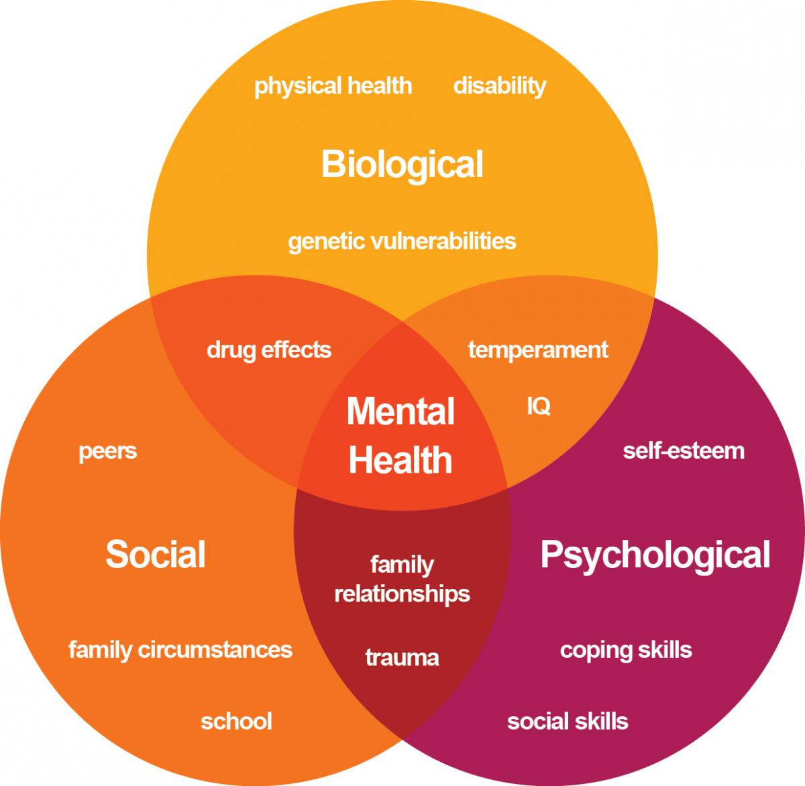
CRISIS FACTORS
Financial
Psychosocial
Environmental
-Lack of natural supports/inclusive community resources.
-Behavior problems.
-Lack of medical and mental health care.
-Interpersonal
and family conflicts.
-Hospitalization/
trauma/
lack of effective coping strategies.
-Educational problems/inadequate settings.
-Immigration status.
-Housing conditions/potential eviction.
-Lack of adaptive
equipment.
-Interactions with
the legal system/crime/
harassment.
-Lack
of employment/income.
-Lack of
government subsidies/
entitlements.
-Lack of
medical insurance.
-Financial Debt/lack of
knowledge about
financial solutions.

Slide 4
IMPACT OF CRISIS
Behaviors
Stuck/Numb
Changes in sleeping patterns
Changes in eating patterns
Use or increase of substances
Angry outbursts/arguments
Loss of interest in leisure activities
Hygiene/home cleanliness
Negligence
Crying
Potential abuse
Missing school
Isolation
Feelings
No way out of this
No one cares
I feel stress
I am so angry, I feel lost
I feel tired and depressed
I cannot take it anymore
I just want disappear
I give up...hopelessness
CRISIS

Slide 5
The philosophy of YAI'S Crisis Intervention is to strengthen the supports for families so they are able to maintain and stabilize the family unit, and to reduce the potential for emergency room visits, out of home placement or involvement with ACS.
Our model contains two parts,
first is the stabilization of the crisis and
the second is a treatment/training/educational component.

Slide 6
CRISIS INTERVENTION SERVICES
Case
management
Behavior management
Counseling
Family Reimbursement
Emergency Respite

Slide 7
ELIGIBILITY PROCESS
REQUIRED PAPERWORK
ELIGIBLE!
Recent psychological and psychosocial evaluations.
Recent medical exam.
IEP (if person is under 21)
Educational records/or any other documentation requested by OPWDD (if the person is over 21)
CHOICES
-Person completes the Front Door process, then added to CHOICES for final approval in order to receive services.
NO EVALUATIONS
- Schedule expedite evaluations through agency.
- No medicaid, expedite free evaluation through agency.
OPWDD RESPONSE
PREPARE PACKAGE
-Eligibility Approved
(Assist the person in completing the Front Door process)
-Required documentation is prepared and send out to OPWDD for review and approval.
OPWDD RESPONSE
-Eligibility Denied
(explore needed documentation to reapply for eligibility) .

Slide 8
CRISIS CASE MANAGEMENT
How do we help!
-Assist in obtaining medicaid, if necessary.
-Assist in the eligibility process.
-Conduct home visits to further assess the needs of the family.
- Accompany family to important appointments (ex; medical, human resources, court, housing, and schools).
-Assist in obtaining other family support services, make referrals, link to other agencies.
-Assist in obtaining Medicaid Service Coordination to receive long term services (waiver services).
Short Term
Case Management

Slide 9
CRISIS COUNSELING
How do we help!
- Crisis Counseling is a short-term, solution focused intervention to assist overwhelmed caregivers in order to reduce stress and promote emotional and mental health wellbeing.
- Services can be delivered in the home or office setting. Specifically the setting that works best for the family.
- The focus of the counseling is to teach coping and problem solving skills in order to avoid a future crisis.
Short Term
Counseling
–

Slide 10
CRISIS BEHAVIOR MANAGEMENT
How do we help!
Empower parents to address challenging behaviors - in your home.
How to handle their children’s difficult behaviors in a more positive and effective way.
Enhance family interaction.
Encourage individuals’ independence.
Improve communication skills.
Short Term
Behavior Management

Slide 11
How do we help!
Hitting
Scratching
throwing on the floor
Refusing to go to school
Self injurious behaviors
Screaming
Biting
Kicking
Destroy property
Non complaining
Removing own clothes
Talking back
ASSESSMENT
Clinician learns more about the individual and the target behaviors through a combination of caregiver interviews and behavioral measures. Data collection
PARENTS TRAINING
Training includes education about care giving styles and child development, as well as teaching behavioral techniques through videotape modeling, role play, and feedback sessions.
BEHAVIOR PLAN
Caregivers and the clinician develop a detailed behavior plan that includes specific behavioral techniques to use when dealing with problem behaviors and a positive behavioral structure, such as a chore chart or daily schedule.
After one month, modifications can be made.

Slide 12
CRISIS FUNDS
How do we help!
-Emergency Respite help pay for respite services in an emergency situation:
*Medical hospitalization and recuperation
*Attending a funeral
*Family member sickness
*Assistance with challenging behaviors
-Family Reimbursement help pay for goods and services which are not reimbursed or obtained through other sources.
-Both of these programs help the family ease some of the financial burden.
Emergency Respite/
Family Reimbursement

Slide 13
Crisis Case
Caregiver called into the Crisis line requesting services for her 7 year old son Alex who was previously diagnosed with Autism at age 3.
Caregiver is a single mother with two other kids ages 2 and 5.
Caregiver has concerns about being deported due to her legal status.
Caregiver does not have a support system and is currently unemployed.
There are no community support services in place, caregiver was not aware of the services provided to people with developmental disabilities.
Caregiver is having financial difficulties and is at risk of being evicted.
Alex exhibits challenging behaviors (non compliance behaviors and hitting) at home as well as in school and everyone is having a hard time dealing with his behaviors.
Caregiver thinks that his current educational setting does not meet his current needs.
Caregiver is dealing with the death of her mother, who passed away six months ago, her mother was Alex and caregiver’s main support system.
Caregiver feels burned out, depressed and lost.
Caregiver struggles completing daily activities and taking care of her children’s needs.

Slide 14
PRESENTING NEEDS
Case Management
Behavior Management
Emergency Respite/Family Reimbursement
COUNSELING

Slide 15
CRISIS INTERVENTION
Alex’s Case
Short Case Management
(eligibility, housing, link to other agencies, support services, school setting, MSC)
Counseling:
(stress, legal status, loss of family member)
Behavior Management:
(Setting limits
and
structure routine)
Emergency Respite
(Natural Support- caregiver able to have a break)
&
Family Reimbursement
(clothes-mattress)

Slide 16
YAI Crisis Intervention
212 273 6200
Thank You

