Slide 1
Intro to Special Education
Presented by:
Lilliana Díaz-Pedrosa

Slide 2
Today’s Training
Introduction
Special Education Law
The Special Education Process
Know Your Rights
Notes:
FORMATTING NOTE – I USUALLY PICK A COLOR FOR EACH SECTION AND THEN MATCH THE COLOR WITH THE COLOR OF THE TEXT IN THE HEADING.

Slide 3
What is Advocates for Children (AFC)?
AFC is an independent agency that protects the rights of all NYC students
Our Services:
Helpline: 1-866-427-6033 (Mon-Thurs, 10am – 4pm)
Guides and resources: www.advocatesforchildren.org
Workshops and trainings
Free legal services to low-income families
Notes:
Founded in 1971 by parents of students with disabilities, mission has expanded over the years
AFC Projects (could be its own slide, depending on the training):
Early childhood
Charter Schools
NYS-TEACHS (homelessness)
Immigrant students English Language Learners (ELLs)
School justice (suspensions and court-involved youth – school-to-prison-pipeline)
Child welfare involved families
Overage, older students
New – bullying, particularly LGBTQ students

Slide 4
The Law for Students with Disabilities
Notes:
There are two federal laws that provide rights to children with disabilities in school: s. 504 of the Rehabilitation Act and the Individuals with Disabilities Education Act (IDEA). Today, in the interest of time, I am going to focus on the IDEA, but you should be aware that section 504 also provides accommodations for students and parents with disabilities.

Slide 5
The Rules
Individuals with Disabilities Education Act (IDEA)
Section 504
NYS Education Law and Regulations “Part 200’s”
NYC Chancellor’s Regulations
NYC DOE Standard Operating
Procedures Manual (“SOPM”)
for Special Education
There are rules?
Notes:
Optional slide, depending on expertise of audience – includes hyperlinks, could add citations

Slide 6
Section 504 of the Rehabilitation Act
Outlaws discrimination based on disability
Schools must make reasonable accommodations
Rights apply to parents, too
Accommodations go in a 504 Plan. Examples:
Classroom accommodations
Testing accommodations
Nursing services
Physical modifications
Notes:
“No otherwise qualified individual with a disability . . . shall be excluded from participation in, be denied the benefits of, or be subjected to discrimination under any program or activity receiving federal financial assistance.” 29 U.S.C. § 794
Disability is a ‘physical or mental impairment that substantially limits one or more major life activities’
Includes people with a record of having such an impairment and people perceived to have an impairment
Section 504 also requires schools to make reasonable accommodations for student’s whose parents have disabilities
Classroom: preferential seating, large print
Testing: extended time, breaks, questions read aloud
Nursing: medication, insulin screening, asthma plan
Physical mods: ramp, elevator, accessible bathroom

Slide 7
Individuals with Disabilities Education Act
IDEA: All children (through age 21) with a disability…
Have the right to a
Free
Public
In the
Least
Appropriate
Education
Restrictive
Environment
FAPE
LRE
Notes:
Notes for slide – all of the text is animated. Click or use the forward arrow to make the text appear. After “Education” in the purple box appears, click on the “Individuals with Disabilities Education Act” title for “FAPE” to appear below the purple box. Then, continue to click or use the forward arrow to make “In the,” “least,” etc. to appear. After “environment” in the teal box appears, click on the AFC logo (pencil) for “LRE” to appear below the teal box.

Slide 8
Classifications
Classifications of disability…
Autism Deafness Deaf-Blindness Emotional Disturbance Hearing Impairment Learning Disability Intellectual Disability | Multiple Disabilities Orthopedic Impairment Other Health Impairment Speech or Language Imp. Traumatic Brain Injury Visual Impairment
Children ages 3-5 will be classified as a
“preschool student with a disability.”
Notes:
Only 13 possible classifications
Disability must “adversely affect a child’s educational performance”

Slide 9
Free Appropriate Public Education (FAPE)
FAPE = programs and services designed for the student’s unique needs
Must provide a meaningful benefit
Helps the student progress
“A Chevy, not a Cadillac”
Notes:
The definition of “appropriate” comes from a Supreme Court case, Board of Education of the Hendrick Hudson Central School District, Westchester County v. Rowley, 458 U.S. 176 (1982).

Slide 10
Least Restrictive Environment (LRE)
Goal is inclusion
As much as possible, students with disabilities learn with students who do not have disabilities
Notes:
Students attend special education classes or schools only when their disability requires it

Slide 11
Supports & Services
Assistive Technology (AT)
Paraprofessionals
Related Services
Counseling
Nursing
Occupational Therapy (OT)
Physical Therapy (PT)
Speech and Language Therapy and more…
Special Education Teacher Support Services (SETSS)
Students can get these in any school setting!
Notes:
AT: Assistive technology is any piece of equipment, product, or system that is used to increase, maintain, or improve the functional capabilities of a child with a disability. Examples: Communication device, FM unit, computer
Paras: To address a child’s individual needs and allow them to benefit from instruction. Examples: Behavior (crisis), health, special transportation
Related services – WHAT ARE SOME OTHER EXAMPLES? audiology services, interpreting services, psychological services, orientation and mobility services, parent counseling and training, vision services, appropriate access to recreation, including therapeutic recreation, other appropriate developmental or corrective support services, and other appropriate support services (i.e., transition services, travel training)
SETSS (resource room): specially designed instruction from a special ed teacher; can be direct/indirect, pull-out or push-in and individual or group (up to 8). May be provided between 3 hours a week and 50% of the day. They do not have SETSS for preschool aged students with special education needs. Those students might have a SEIT (special education itinerant teacher), who is always 1:1. Infants and toddlers who receive Early Intervention can receive Special Instruction.
Talk about RSAs here!!!

Slide 12
Continuum of Services
General Education with Supports/Services
More restrictive
Integrated Co-Teaching (ICT)
Little more
Special Class in a Community School (self-contained)
12:1+1; 12:1; 15:1
Least Restrictive
Notes:
As we discussed, students must be placed in the LRE to meet their needs. Special education programs and services fall on a continuum. So, from least to most restrictive…
General education with supports/services
Integrated Co-Teaching (ICT) classrooms include both special ed and general ed students who are taught together by a special ed and general teacher. (May only be for certain subjects or part of the day – can have combo of SETSS, ICT and special class). Mention ASD NEST
Special Class means the student is in a self-contained classroom for at least some part of the school day. They serve children whose needs cannot be met within the general education classroom, even with supplementary aids and services.
Students are grouped by similarity of educational needs. SO classes may contain students with the same disability or with different disabilities as long as they have similar levels of academic and learning characteristics, levels of social development, levels of physical development and management needs.
Mention ASD Horizon, ACES.
NOTE: Special Ed Reform - Students will be enrolled at their local or “choice school” unless they require specialized programs. Schools are expected to create programs to meet students’ needs as mandated on their IEPs. Key takeaway is that schools should not be changing students IEPs to meet what they have available but rather creating programs within their schools to meet the needs of all of their students. Contact AFC if you are working with a child whose school cannot meet the mandates on the child’s IEP.

Slide 13
Continuum of Services
Getting restrictive
Special Class in a Specialized School (District 75)
12:1+1; 8:1+1; 6:1+1; 12:1+4
Even more so
State Approved Non-Public School (NPS)
Home Instruction
Very restrictive
Most restrictive
Residential Placement
Notes:
District 75 is a separate school district intended for students who have severe needs that require more intensive support. Mention D 75 inclusion.
State Approved Non-Public Schools – Private special ed schools approved by the state for students whose educational needs cannot be met in a public school program.
IEP program recommendation will say “defer to Central Based Support Team (CBST).”
The CBST is a DOE office that matches state-approve private special ed schools with students.
Residential – For students who require services on a 24-hour basis.
Home instruction – available to students with severe physical/medical or emotional conditions that make attending school impossible
Only allowed when “medically necessary”; requires documentation from a physician/psychiatrist
Usually intended to be temporary
5 hours/week for grades K-5; 10 hours/week for grades 6-12
Chancellor’s Regulation A-170

Slide 14
The Special Education Process
Referral
Consent
Evaluation
IEP
Development
Placement/Services

Slide 15
Pre-Referral Interventions
Help students with academic and behavioral needs
Also called Academic Intervention Services (AIS) or Response to Intervention (RTI)
Required if promotion-in-doubt
Not a special education evaluation
Should NOT delay the special education process
Notes:
AIS can include:
Extended day or Saturday programming
At-risk SETSS (resource room), at-risk speech
Small group or 1:1 reading or math intervention (Wilson, Read 180, Great Leaps)
Smaller academic intervention or at-risk classes
Non-academic supports such as at-risk counseling, attendance interventions, or behavior plans

Slide 16
Referral
Who can make a referral for special education?
Parent/legal guardian or the school
How to refer?
In writing (keep a copy!)
Send a letter to the principal, school-based support team and/or committee on special education
Child Find
The school must refer a child for evaluation if it thinks the child has a disability

Slide 17
Consent
Within 10 school days of referral, the school must ask the parent for consent to evaluate
Watch for delays here!
Consent must be written, voluntary, and informed
The parent can withdraw consent at any time
Notes:
Because the timeline starts with consent must watch out for delays!
Typically occurs at the social history interview
Discuss “Informed”
Must occur in the parent’s language

Slide 18
After Consent to Evaluate
The following must happen within 60 school days:
Evaluation(s)
IEP Meeting
Placement/Services
Notes:
School days v. calendar days (vacation, weekends, holidays etc.)

Slide 19
What Should an Evaluation Include?
Students must be tested in all areas of suspected disability
IEP
Social history
Psycho-educational
Classroom observation
Any other areas of concerns
Recent physical
Notes:
Social history is usually when due process rights are given to parent.
Recent physical – usually within one year
Ask for specific evaluations if needed! Some examples:
OT, PT, Speech, AT, FBA, etc.

Slide 20
Evaluations
Must be bilingual, if the student uses a language other than English
Free
School must evaluate every three years, but up to once a year
Parents have a right to copies
Notes:
Explain testing for non-verbal students w/ native language
Sometimes DOE asks for insurance for evals and other related svcs, but not necessary
Explain triennial and right to request evaluations more frequently – different than progress reports!

Slide 21
What is an IEP?
Individualized
Legally binding (like a contract)
Everything on the IEP must be given to the student
Good for one year
Notes:
Individualized Education Program
Based on what student needs, not what school has – each student’s should look different
Must review at least once a year, but you can always request to have an IEP meeting!

Slide 22
The IEP Meeting
Who is at the meeting?
Parent(s)
Special
Education
Teacher
General Education Teacher
If the student is or may be in general ed classes
Have right to 5 days notice
Other Persons
Student
School Psychologist
District Representative
Including interpreters
Explains evaluations or change in setting
As appropriate (15 or older)
Knows district services
Notes:
22
Parents have the right to attend IEP meetings! They should be given notice of the meeting at least 5 days in advance. If you cannot attend the meeting, you have the right to reschedule. Your attendance is crucial.
At the IEP meeting, the team will:
Consider the results of evaluations, including any independent evaluations
Consider the strengths and needs of the student and his/her present levels of performance
Determine if the child is eligible for special education services
Decide what services and accommodations the child needs based on his or her disability
District Representative – representative of the district who is qualified to provide or supervise special ed and who is knowledgeable about the general ed curriculum and the resources available (this role may be filled by the special education teacher or the psychologist)
Students must be invited to participate in IEP meetings where transition planning is or should be discussed. Transition planning must begin starting with the IEP that will be in effect when the student is 15.

Slide 23
Tips for IEP Meetings
Ask for any reports or evaluations before the meeting
Sign and get a copy of the attendance sheet
Get a draft of the IEP after the meeting
Get the finalized IEP. Compare it to your notes!
Notes:
Except for preschool aged students, schools rarely share evaluations, reports, or draft goals before meetings. Ask for the documents! Parents have the right to reports 5 days ahead of the meeting. They are rarely ready by then, but you can and should get them ahead of time. Read them, take notes, and write down questions or ideas you may have ahead of time.
Signing the attendance form does not indicate agreement with recommendations, it just means that you were preset. The attendance page should reflect “TO” or by telephone for those participating by phone. Parents can participate by phone if they choose. So can others (i.e., outside therapist, tutor, etc.)
If schools won’t give you a draft IEP, take a picture. Even if nothing is printed out, you can usually see something on the computer screen.
Notes – bring binder, folder with your child’s documents, tabs; special education guide, due process rights; you are a professional parent; can step out, take a break.

Slide 24
Important Sections in an IEP
Present Levels of Performance
Recommended Program
Related Services/ AT
Testing Accommodations
Parent Concerns
FBA/BIP
Annual Goals
Transition Plan
Promotion Criteria

Slide 25
Program Recommendation
Prior Written Notice
Describes program, type of school and services on IEP
School Location Letter
Says which school the student should attend
Parents have the right to visit
All community schools SHOULD be able to meet the needs of most students!

Slide 26
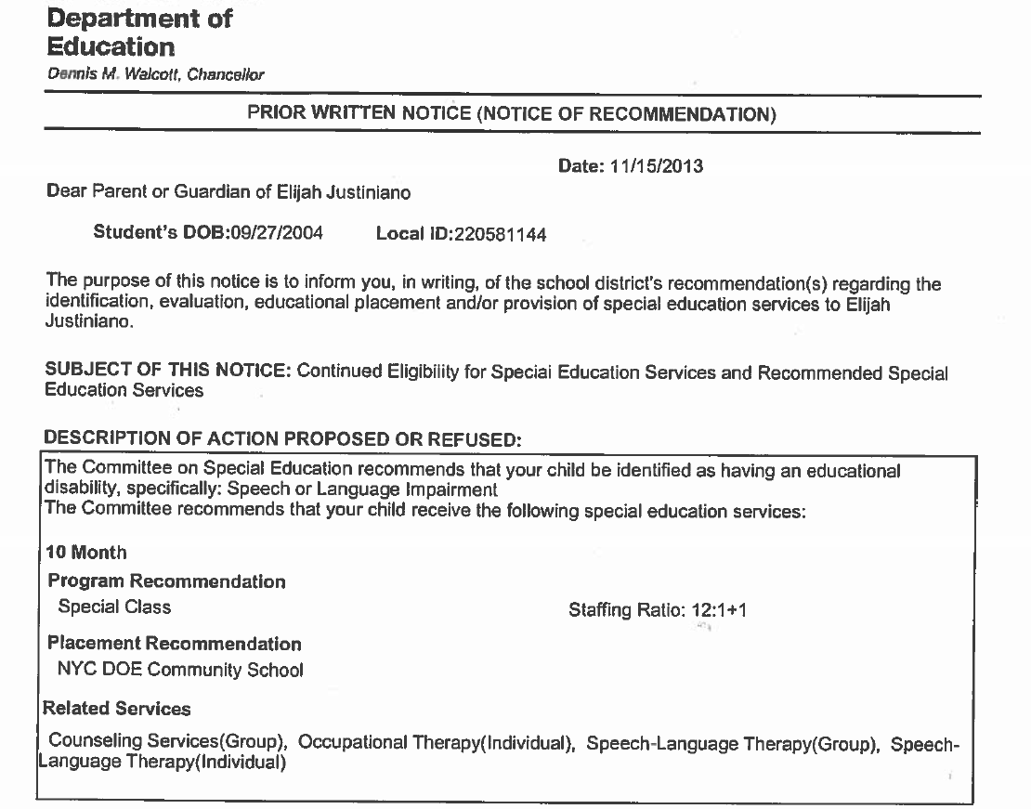
Notes:
Describes IEP Program and Services
NOTE: ALL community schools SHOULD be able to meet the needs of MOST students.
Special ed reform: CALL US!!!
Parents should receive a “Prior Written Notice” form at the meeting or by mail, which will include a proposed school. For an initial placement into special education, and when a child is first referred to a 12-month program, the parent’s consent will be required before services will be provided. Otherwise, the form may say something like, if we don’t hear from you by a certain date, the proposed changes will go into effect. Will be a separate page called a “School Location Letter” that lists the school to which a student has been assigned.

Slide 27
What if You Disagree with the DOE?
Due Process Rights
Informal Dispute Resolution
Formal Dispute Resolution

Slide 28
Informal Dispute Resolution
Start with the School
Teacher, Parent Coordinator, School Psychologist, Principal
Superintendent’s Office
Family Support Coordinator or District Family Advocate
Borough Field Support Center
Administrator of Special Education, Supervising Psychologist
DOE Central
Special Education hotline: (718) 935-2007 or call 311

Slide 29
Formal Dispute Resolution
Facilitated IEP Meeting
Mediation
State/ OCR Complaint
Impartial Hearing
Notes:
Make sure you have a resolution or remedy in mind!!
RSA: In cases where neither the DOE nor contract agency staff are available, a Related Service Authorization (RSA) allows the parent to identify an independent provider at no cost to them. The parent is provided with information about available providers, instructions about how to use the RSA, and information about whom to contact at the DOE for assistance.
Nickerson Letter: Can get a Nickerson Letter when:
Child has not received special ed before AND is recommended for a special class AND DOE fails to provide an appropriate placement within 60 school days from consent. OR
Child is in special ed AND does not receive a specific placement within 60 school days of the child being re-referred for the spec ed review process OR does not receive specific special ed placement for the following year by August 15
A Nickerson Letter requires the DOE to pay tuition for the school year of any state-approved special education non-public school that accepts the student. Parents are provided with a list of eligible NPS schools when they get the Nickerson Letter.

Slide 30
Parents Have the Right to…
Consent to or reject special education
Request new evaluations, including independent evaluations
Fully participate in all IEP meetings
Have an interpreter who speaks your language and get documents translated
Get notice in writing before the school changes a child’s placement, classification, or services
REMINDERS
Notes:
Though the DOE should be aware of a parent’s language of preference, parents can request translation and interpretation services directly from the DOE.

Slide 31
Call us with questions!
Helpline: 866-427-6033 (toll free)
Monday-Thursday, 10am-4pm
info@advocatesforchildren.org
Notes:
Thank you for coming! Please complete our evaluation before you go.
Remind audience that this process is complicated, with lots of information, won’t be able to answer all questions…
So they should call us with questions!!
Use our guides!
Go to more workshops!

Slide 32
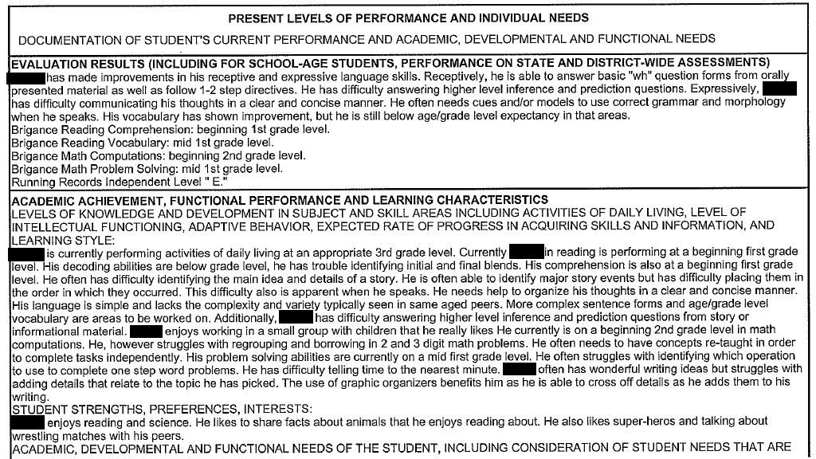
Present Levels of Performance
Notes:
**Note that also section for levels of social and physical development

Slide 33
FBA/BIP

Slide 34
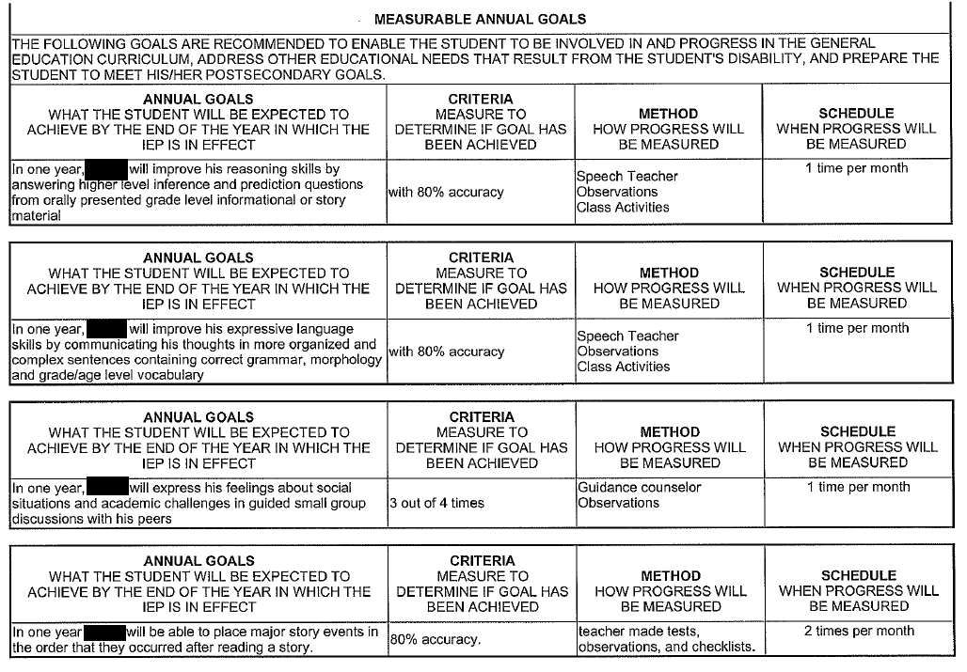
Annual Goals

Slide 35
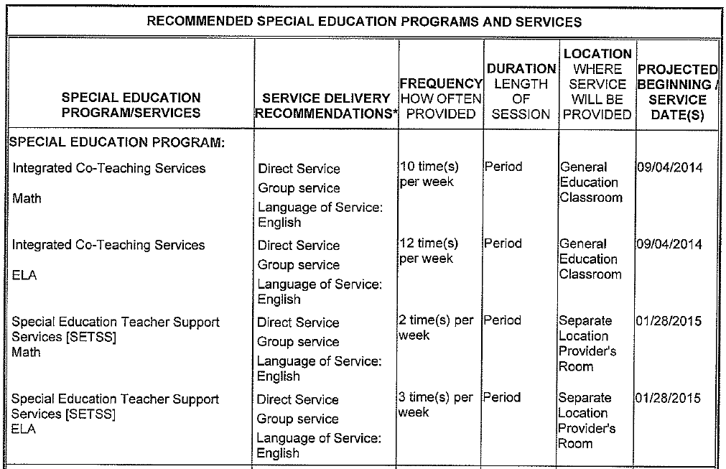
Recommended Program

Slide 36
Related Services/ AT

Slide 37
Testing Accommodations

Slide 38
Transition Plan

Slide 39
Promotion Criteria

Slide 40
Parent Concerns

Slide 41
Parent Concerns

