Slide 1
Adult Services: What You Need to Know
Presented by
Manhattan DD Council Transition Committee

Slide 2
OPWDD & ACCES-VR
OPWDD
NY State Office for People With Developmental Disabilities
Services for people with developmental disabilities
Available services include supported employment, day habilitation, and other support services
ACCES-VR
NY State Adult Career & Continuing Education Services-Vocational Rehabilitation
Career counseling and employment assistance for people with all disabilities

Slide 3
ACCES-VR
ACCES-VR services focus on employment
To access services, you must attend an information session and submit an application with proof of disability
Career counselor helps create an individual employment plan for the person
Referrals may be made for vocational evaluations, training and education programs, supported employment services, and tuition subsidy
To access employment services through OPWDD, including supported employment, you have to go through ACCES-VR first

Slide 4
OPWDD
Services support people with developmental disabilities in different areas of life including employment, daily living skills, recreation, etc.
Services are provided through various agencies (e.g. AHRC, YAI, ADAPT, Sinergia, Lifespire)
To access services, you must establish eligibility and complete the Front Door process
All services must be approved by OPWDD based on need
Services paid for through Medicaid and state family support funding

Slide 5
OPWDD: Adult Day Services
Supported Employment
Paid employment with support from a job coach
Day Habilitation – Without Walls
Structured activities in the community
Day Habilitation – Traditional/With Walls
Structured activities both in a program building and in the community
Community Habilitation
1:1 skills development service at home and in the community

Slide 6
OPWDD: Other Employment Supports
Employment Training Program (ETP)
Up to one year paid internship
Wages are paid by OPWDD with the understanding that the person will be hired at the training site
Pathways to Employment (PTE)
Up to one year of multiple unpaid internships and support services
Goal is to help the person explore career experiences and develop a plan for employment

Slide 7
OPWDD: Other Services
Community habilitation
Community inclusion and help learning daily living skills
Respite
Short-term care to give the family a break, either at home or at a separate location
Behavior Management
Assists family with strategies for managing challenging behaviors at home
Family Reimbursement
Reimbursement for goods and services, up to $500 a year

Slide 8
OPWDD: Self-Direction
Annual budget that can be used to fund individualized supports and services
Annual budget is based on the individual’s needs and expenses must be approved by OPWDD
A specialized broker works with the family and Care Manager to manage the budget
Fiscal Intermediary coordinates payments

Slide 9
OPWDD Eligibility: Required Documents
Psychological Evaluation (within 3 years)
Must include IQ and adaptive behavior scales
Psychosocial Evaluation (within 1 year)
Medical Report (within 1 year)
Criteria for eligibility:
Developmental disability diagnosis: Cerebral palsy, intellectual disability, epilepsy, autism, neurological impairment, familial dysautonomia, traumatic brain injury
Diagnosis prior to age 22
Disability causes substantial deficit to a person’s ability to function independently
Evaluations can be obtained from an Article 16 clinic
Medical Report and TB test results can be requested from your child’s doctor

Slide 10
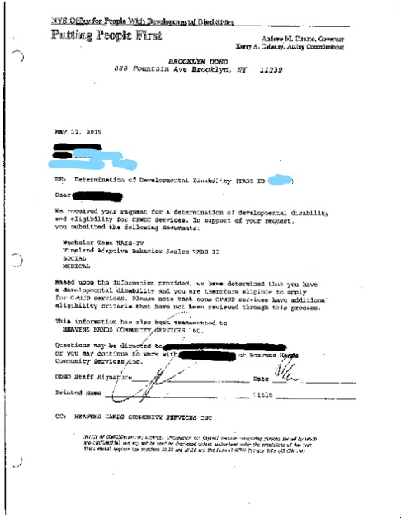

Slide 11
Making Medicaid Work for You
OPWDD waiver services are funded through Medicaid
Types of Medicaid:
Medicaid with Community Based Long Term Care (“Straight Medicaid”)
Managed Care Medicaid
Medicaid with Managed Long Term Care (MLTC)
Not possible to have both waiver services and MLTC
Supplemental Security Income (SSI)
At 18, people can apply based on their own income
Can apply before age 18 to establish Disabled Adult Status (DAC), even if they don’t qualify based on family income
Once you have SSI, you automatically enroll in Medicaid

Slide 12
OPWDD: Front Door Process (Part 1)
Front Door Information Session
Explains the services available through OPWDD and the process for obtaining them
Front Door Phone Interview
Interview with a Front Door facilitator about the person’s abilities and needs, used to determine need for services

Slide 13
OPWDD: Care Coordination
Care Manager: case manager who helps apply for and coordinate OPWDD services
Required in order to receive most OPWDD services
Available through Care Coordination Organizations (CCOs):
Advance Care Alliance
Care Design NY
Tri-County Care
CCOs may be able to assist with obtaining OPWDD eligibility and the Front Door process

Slide 14
OPWDD: Front Door Process (Part 2)
3. Service Request & Authorization
Individual services are requested, reviewed, and authorized by OPWDD’s Front Door team
Care Manager and Front Door facilitator work together to process service requests
People new to services have to enroll in OPWDD’s Medicaid waiver
Happens at same time as service authorization request if person is new to waiver services

Slide 15
Other Things to Think About
Guardianship
Supplemental Security Income (SSI)
NY State/NYC ID Card
Adult Medicine
Therapies & Counseling
Supplemental Needs Trusts
Home Care Services
Benefits & Work Incentives Counseling
Housing

Slide 16
Transition Planning in Schools
Transition Focused IEP (age 15+)
Student included in meeting
Measurable Postsecondary Goals
Coordinated Set of Transition Activities
Work-Based Learning
Vocational Assessments
Travel Training

